Slide 1
Introduction
Business Analytics

Slide 2
Business Analytics
Business analytics: The process of analyzing data to gain valuable insights and inform business decisions.
Descriptive analytics: what has happened?
e.g.: Financial reports, public health statistics, student transcripts
Predictive analytics: what could happen in the future?
e.g.: predicting sales based on marketing, detecting potentially fraudulent credit card transactions
Prescriptive analytics: what should we do?
e.g.: scheduling employees, adjusting production level, choose investment portfolio, targeting marketing campaigns

Slide 3
Business Analytics
Example: Consider a retail chain that has experienced a stagnant sales over the past year, with little to no growth compared to previous years.
The company’s leadership wants to understand:
what is happening
forecast future trends
determine the best course of action to boost revenue.

Slide 4
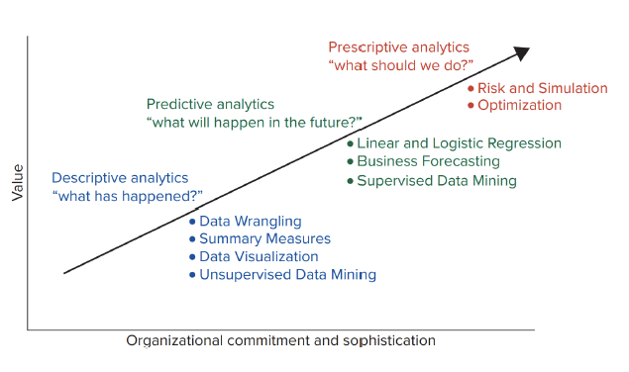
Business Analytics

Slide 5
Types of Data
Data: are collection of facts, figures, or other contents.
Information: is a set of data that are organized and processed in a meaningful and purposeful way.
Population: consists of all items of interest in an analytics application
Sample: is a subset of the population
Representative of the population
Example: 46.8% of Canadians 15 years or older reported high life satisfaction.
Population: Canadians 15 years or older (around 34 million people).
Sample: 2000 individuals who are selected randomly.

Slide 6
Type of Data
Cross-Sectional vs Time Series Data:
Cross-sectional data: Record a characteristic of many subjects at the same point of time, or without regard to time.
e.g.: People, firms, industries, regions.
Seed | Team | Wins | Losses | Win %
1 | Cleveland Cavaliers | 64 | 18 | .780
2 | Boston Celtics | 61 | 21 | .744
3 | New York Knicks | 51 | 31 | .622
4 | Indiana Pacers | 50 | 32 | .610
5 | Milwaukee Bucks | 48 | 34 | .585

Slide 7
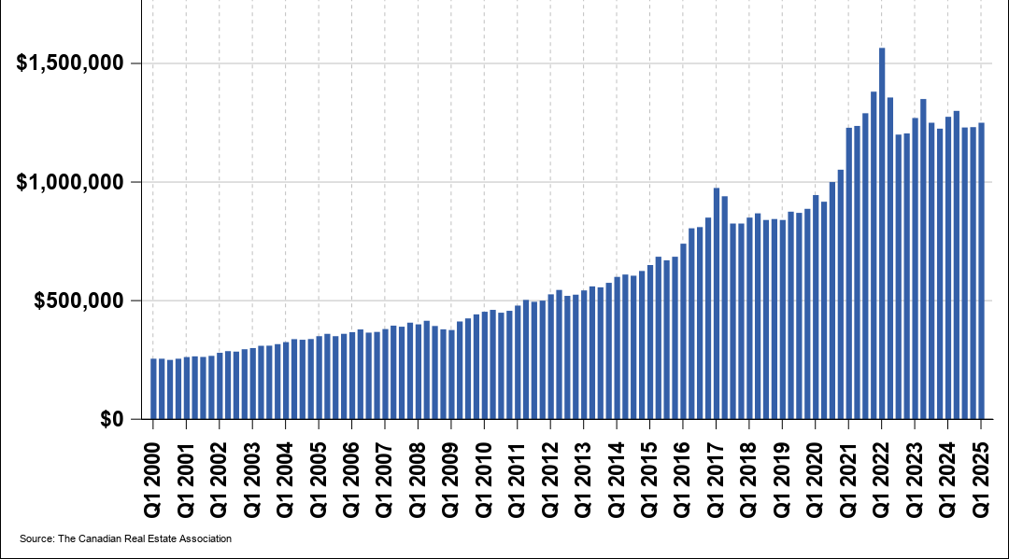
Type of Data
Cross-Sectional vs Time Series Data:
Time series data: Collected over several time periods focusing on certain group of people, specific events, or objects
e.g.: Hourly, daily, weekly, monthly, ...

Slide 8
Type of Data
Structured vs Unstructured Data
Structured data: Exist in a predefined row-column format. We use spreadsheet or data base applications to enter and store them
e.g.: point-of-sale and financial data.
Unstructured data: Do not conform to a predefined row-column format
e.g.: written reports, pictures, videos, social media posts.

Slide 9
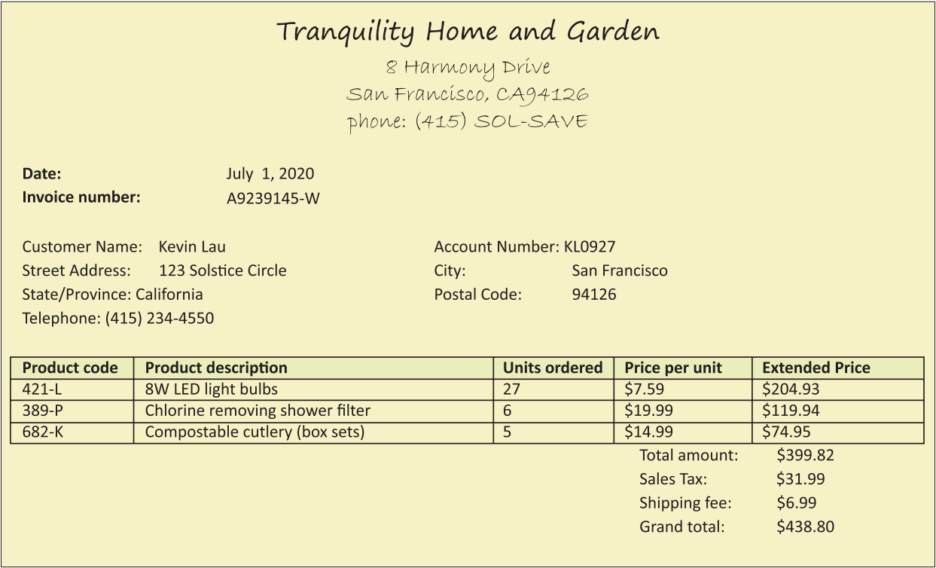
Type of Data
Structured vs Unstructured Data
Structured data: Exist in a predefined row-column format. We use spreadsheet or data base applications to enter and store them
e.g.: point-of-sale and financial data.
Unstructured data: Do not conform to a predefined row-column format
e.g.: written reports, pictures, videos, social media posts.

Slide 10
Type of Data
Structured vs Unstructured Data
Structured data: Exist in a predefined row-column format. We use spreadsheet or data base applications to enter and store them
e.g.: point-of-sale and financial data.
Unstructured data: Do not conform to a predefined row-column format
e.g.: written reports, pictures, videos, social media posts.

Slide 11
Variables and Scales of Measurements
In business analytics, we focus on people, firms, events, etc. with characteristics.
Variable: a characteristic of interest that differs in kind or degree among various observations.
Categorical or qualitative:
Observations of categorical variables represent categories, names or labels
Arithmetic operations on the values are not meaningful
E.g.: marital status, type of industry
Numerical or quantitative:
We use numbers to identify the distinguishing characteristic
Can be discrete or continuous

Slide 12
Variables and Scales of Measurements
Different measurement scales:
Nominal scale (categorical):
Differ by name or label
Least sophisticated level of measurement and they can only be categorized or grouped
Company | Exchange | Company | Exchange
3M (M M M) | NYSE | Johnson & Johnson (J N J) | NYSE
American Express (A X P) | NYSE | JPMorgan Chase (J P M) | NYSE
Apple (A A P L) | Nasdaq | McDonald’s (M C D) | NYSE
Boeing (B A) | NYSE | Merck (M R K) | NYSE
Caterpillar (C A T) | NYSE | Microsoft (M F S T) | Nasdaq
Chevron (C V X) | NYSE | Nike (N K E) | NYSE
Cisco (C S C O) | Nasdaq | Pfizer (P F E) | NYSE
Coca-Cola (K O) | NYSE | Procter & Gamble (P G) | NYSE

Slide 13
Variables and Scales of Measurements
Different measurement scales:
Ordinal scale (categorical):
Observations can be categorized or ranked
Cannot interpret the difference between the ranked observations
Example: Customer service rating
Category | Rating
Excellent | 5
Very good | 4
Good | 3
Fair | 2
Poor | 1

Slide 14
Variables and Scales of Measurements
Different measurement scales:
Interval scale (Numerical):
Observations can be ranked, and we can find meaningful differences
Zero value is arbitrary and does not reflect the absence of a characteristic
Example: Temperature
Ratio scale (Numerical):
Zero value is not arbitrary and reflects absence of a characteristic
Example: Sales, profit, inventory level

Slide 15
Introduction to Python
Business Analytics

Slide 16
Programming with Python
You can use any IDE for this course.
In the class, I use Anaconda and JupyterLab.
Download Anaconda from: https://www.anaconda.com/download
Once installation is complete, open Anaconda Navigator and launch JupyterLab

Slide 17
Jupyter Notebook
In Jupyter Notebook, we have three types of cell:
Raw: Python does not process it
Markdown: We use it to add text
Code: We use it to write python code
We can use ‘#’ to write comments in a code cell
Basic Arithmetic Operators:
Operator | Computer Symbol | Example
Exponentiation | ** | 5 ** 2 = 25
Multiplication | * | 2 * 8 = 16
Division | / | 21/7 = 3
Modulus (remainder) | % | 17%3 = 2
Addition | + | 4 + 5 = 9
Subtraction | − | 9 − 4 = 5

Slide 18
Coding with Python
Variable:
A variable is the name for a storage location in the computer's memory. The value of the variable is what is stored in that location.
We use ‘=’ to assign a value to a variable
Primitive variables:
Numbers: can be integer or float
Strings: texts like variables
Boolean: True or False
Rules for naming variables:
Cannot start with a number
Cannot have space
Cannot use operators' names: e.g., if, and, or, for, True, break, …

Slide 19
Coding with Python
Relational operators
They are used for comparing values or variables
The results of any comparison is a Boolean value; either True or False
Operator | Description | Examples
< | is less than | 3 < 5 is True 5 < 3 is False
<= | is less than or equal to | 6 <= 6 is True 6 <= 3 is False
> | is greater than | 8 > 5 is True 5 > 8 is False
>= | is greater than or equal to | 12 >= 12 is True 6 >= 12 is False
== | is the same as | 15 == 15 is True 12 == 11 is False
! Exclamation= | is not the same as | 4 Exclamation!= 5 is True 4 Exclamation!=4 is False

Slide 20
Coding with Python
Logical operators
They are used to create compound conditions from two or more simple conditions
There three commonly used logical operators in computer programs are and, or, not
Variable A | Variable B | Result of A and B | Result of A or B | Result of not A
False | False | False | False | True
False | True | False | True | True
True | False | False | True | False
True | True | True | True | False

Slide 21
Coding with Python
Functions:
A Function is a block of code that performs a task
Allows programmers to write a block of code once and use it various ways
Usually, we type the name of the function followed by ‘()’ :e.g., print()
Function | Description
absopen paren(X)close paren | Returns the absolute value of X
sortopen paren(list_name)close paren | Sorts a list in ascending order
string.upperopen paren()close paren and string.loweropen paren()close paren | Returns the string in all upper- or lower-case
lenopen paren(X)close paren | Returns the number of items in a string or list
roundopen paren(X, Y)close paren | Rounds a number, X, to the places specified by Y

Slide 22
Coding with Python
Example 1.1: Assume the demand for is a product named MBAI5100 is 1,000 units per month. The unit price of each product is 10.The unit production cost is 5. Answer the following questions:
a) What is the total revenue (print the total revenue is ...)?
b) What is the total profit?
c) How many characters does MBAI5100 have?
d) What is the last character of the name?

Slide 23
Coding with Python
List:
Python cannot work directly in a spreadsheets or database; it must import the data, work on the data, and output the results to a monitor, a file, or send it back to a spreadsheet or data bases.
To work with data, Python stores the data temporarily in structure know as a list – a list of related items.
We use [] to create lists.

Slide 24
Coding with Python
Dictionary:
A collection of key-value pairs where each key is unique and maps to value
Created with {}
You can add, update, and remove items.

Slide 25
Coding with Python
DataFrame:
We are more used to using tables to store and manipulate data.
pandas:
pandas is a powerful Python library used for data manipulation and analysis.
It provides easy-to-use data structures, including DataFrames, which allows you to clean, explore, and analyze data efficiently.
To use panadas, first, we need to import it:
import pandas as pd

Slide 26
Coding with Python
ndarray:
A powerful N-dimensional array.
No need for loops – operations can be applied to entire arrays at once.
NumPy:
Implemented in C, so its operations are much faster than pure Python
Offers a rich set of tools
Pandas is built on top of NumPy

Slide 27
Coding with Python
Example 1.2: Create a dictionary similar to the table below, and then, turn in into a Pandas DataFrame:
Order_Number | Channel | Amount
1010 | Online | 200
1011 | In store | 320
1012 | App | 140

